Slide 2
Building 3D apps with .Net MAUI and Evergine
Jorge Canton – Plain Concepts
Javier Suarez – Microsoft

Slide 3
.NET MAUI
SDK-style projects
Single Project
CLI Support
Visual Studio Windows and Visual Studio Code
Hot Reload
DESKTOP
MOBILE
.NET MAUI
Windows
iOS
File | New
Multi-platform App UI (.NET)
CLI
dotnet install maui
dotnet new maui
Namespace
Microsoft.Maui
macOS
Android

Slide 4
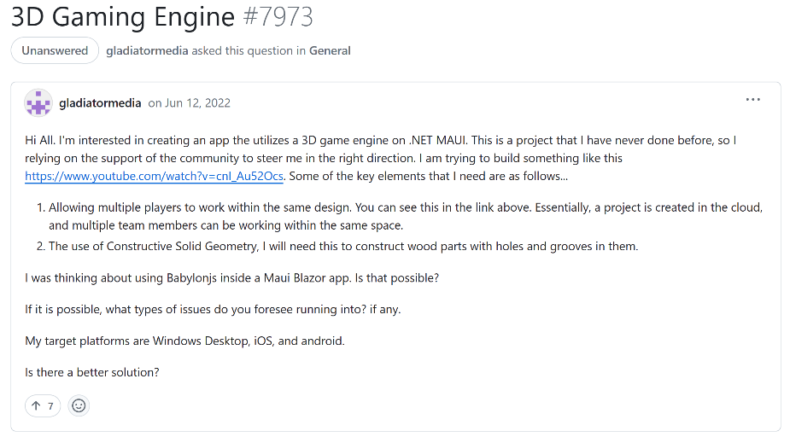
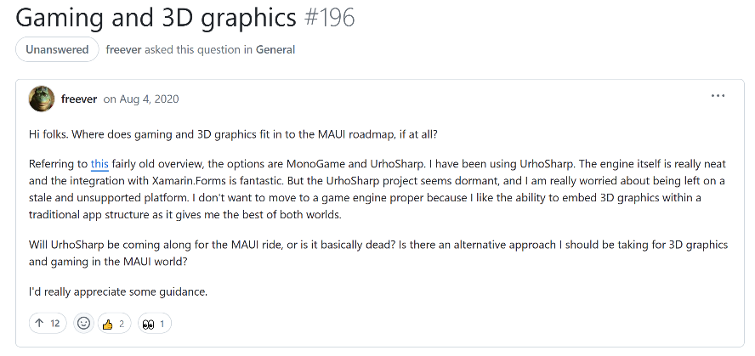
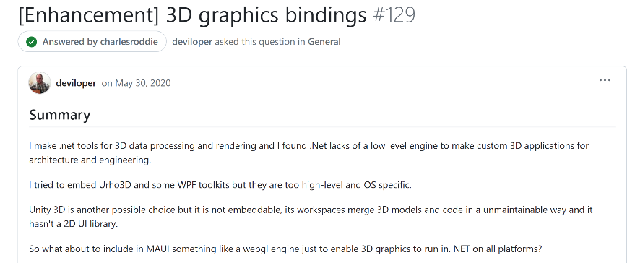
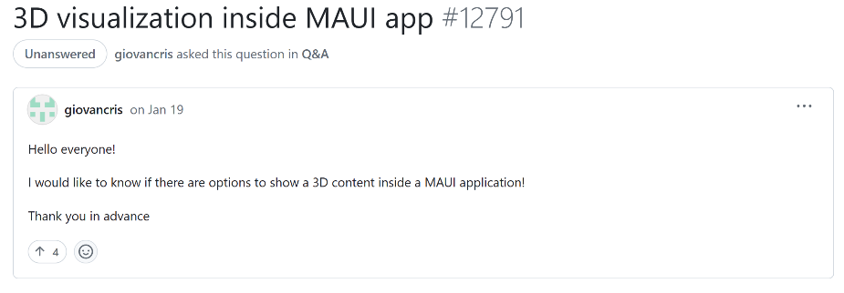
There were a huge number of requests…

Slide 5


What is Evergine?

Slide 6
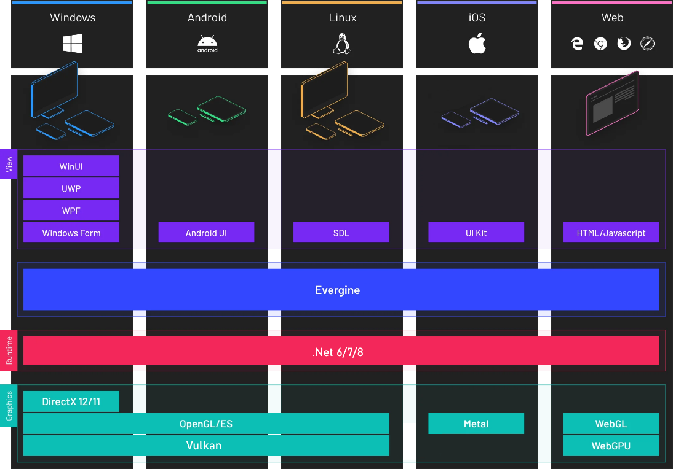
Evergine architecture

Slide 7
Evergine’s use
Free to use
No Licensing fees
No Royalties
Comercial and non-comercial projects

Slide 8
Demo
Getting started with MAUI and Evergine

Slide 9
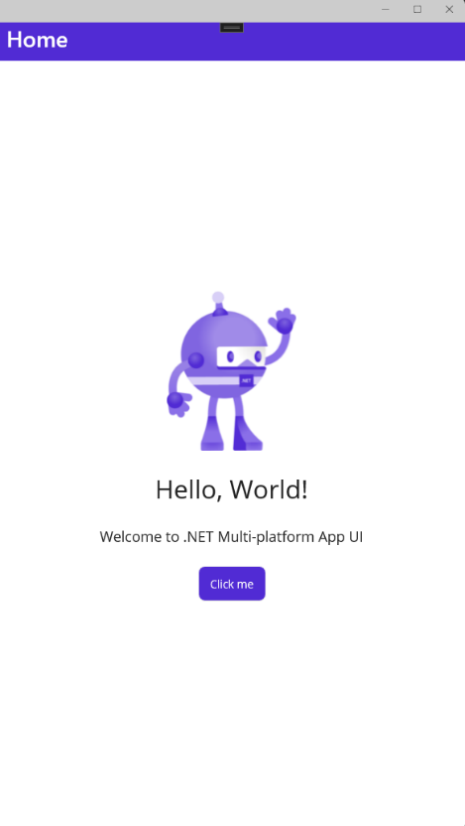
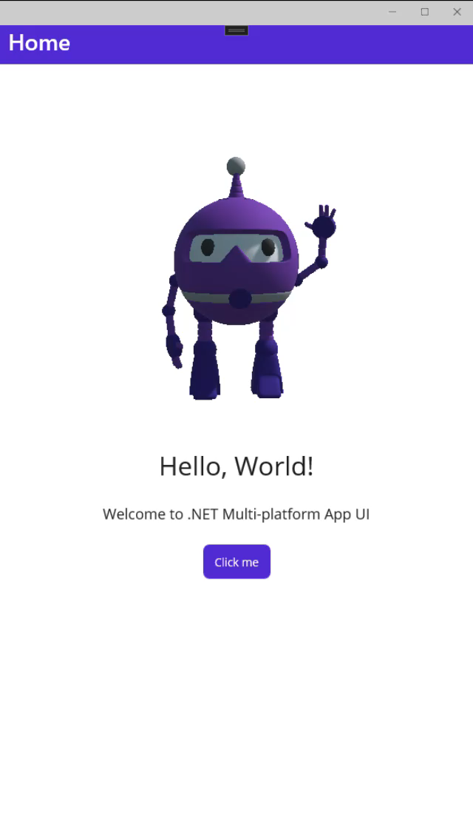
Convert to 3D
Source: https://github.com/Jorgemagic/MAUIDotnetBot

Slide 10


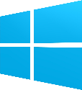
How it works
EvergineViewHandler
(AndroidSurfaceView)
Vulkan
EvergineView
EvergineViewHandler
(SwapChain)
Metal
Evergine Application
EvergineViewHandler
(SwapChainPanel)
DirectX

Slide 11
Demo
MAUI and Evergine showcase app

Slide 12
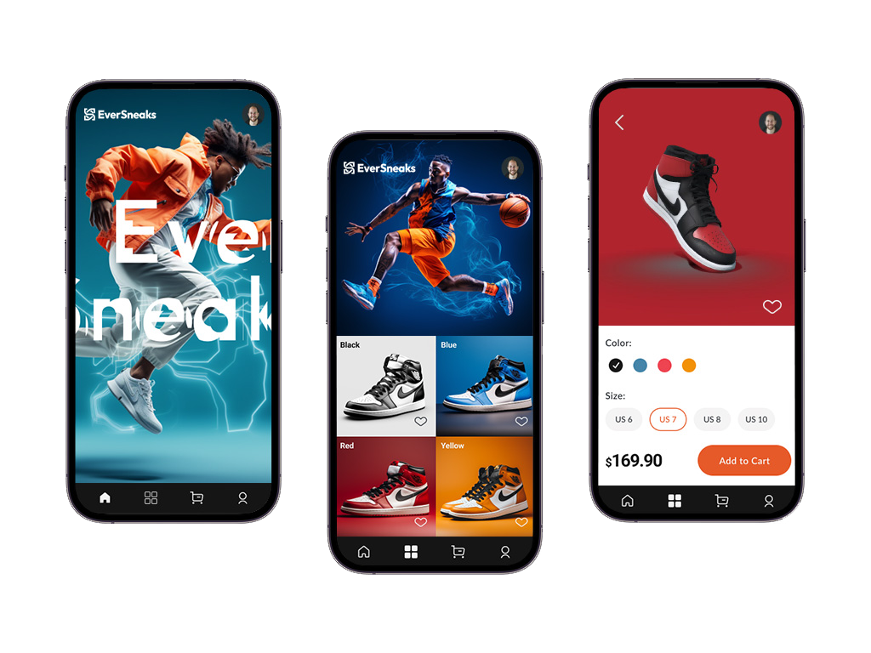
Source: https://github.com/EvergineTeam/EverSneaks

Slide 13
Customer story
Brain – Thera4all

Slide 14

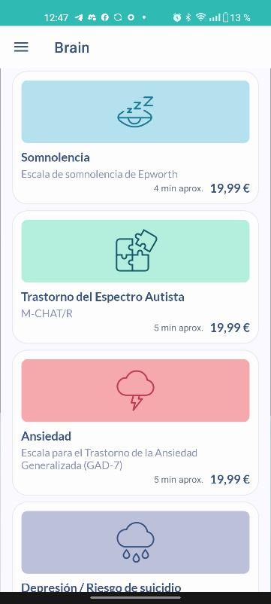
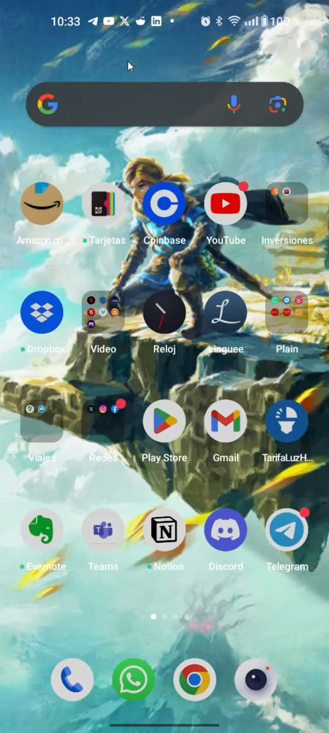

Thera4All

Slide 15

Resources
Evergine https://evergine.com/
.Net blog post https://devblogs.microsoft.com/dotnet/dotnet-maui-3d-app-with-evergine/
DotnetBot demo code https://github.com/Jorgemagic/MAUIDotnet
EverSneaks Showcase code https://github.com/EvergineTeam/EverSneaks
CarRental App UI Challenge https://github.com/jsuarezruiz/netmaui-carrental-app-challenge

